Slide 1
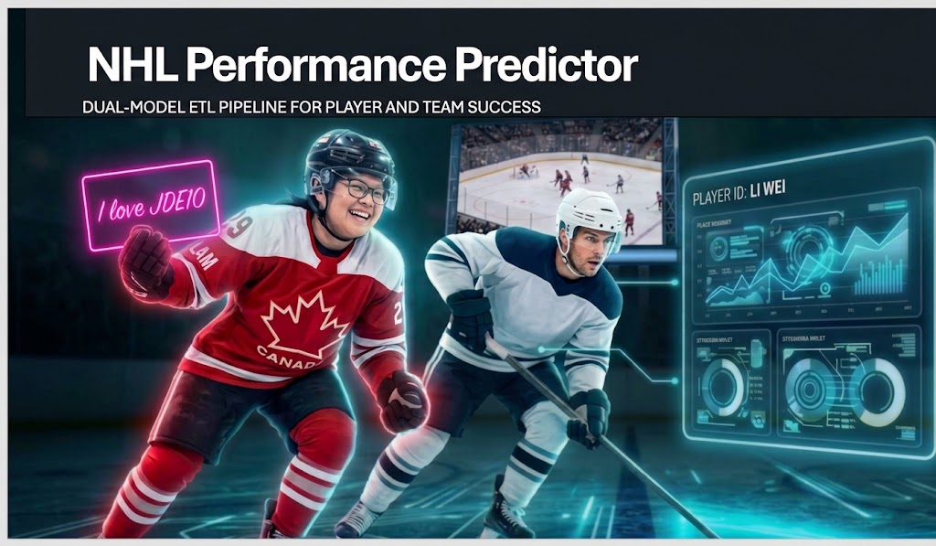
Notes:
Alternative subtitle: Turning Kaggle NHL Data into Winning Insights

Slide 2
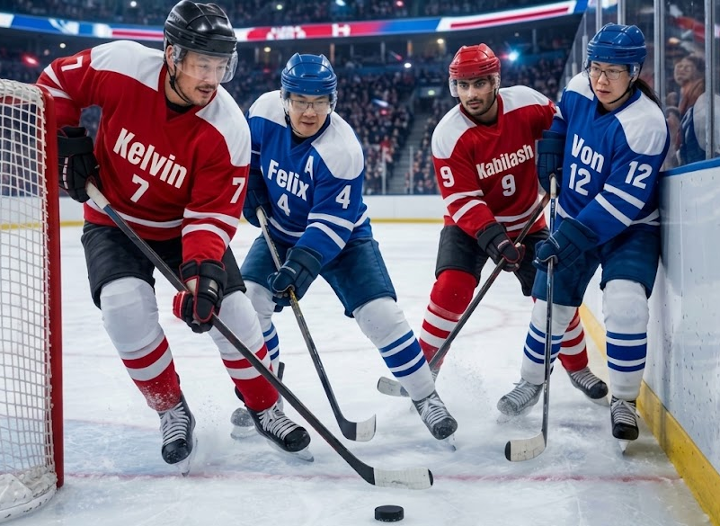
The Winning Strategy: Team Hi5
Kelvin | Felix | Kabilash | Von
From coffee towkays in Philippines to now pro max ice hockey bankers, we are here to share how to make smart sports analytics investments using two winning formulas that will perk up your mornings.
You don't need to sign up for JDE11.
You just need to learn more about our tried-and-tested logistic regression and data modeling.
The Bouncer X The Historian

Slide 3
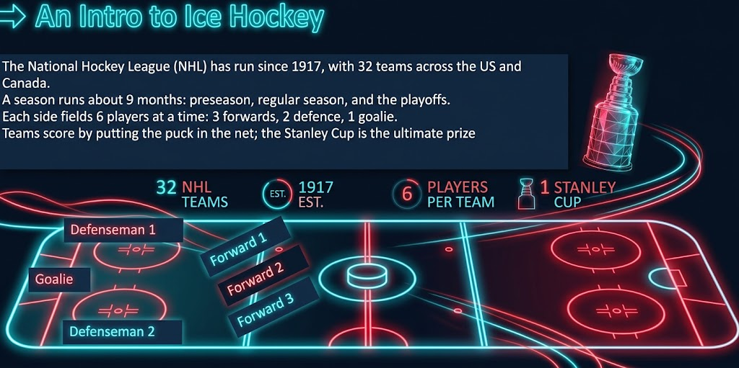
An Intro to Ice Hockey
Scale: 32 teams | 82 games/season | 9-Month period (preseason, regular season, and playoffs)
Lineup: 6 Active Players on ice (3 Forwards, 2 Defensemen, 1 Goalie) along with frequent live-play substitutions that introduce complex team performance variables

Slide 4
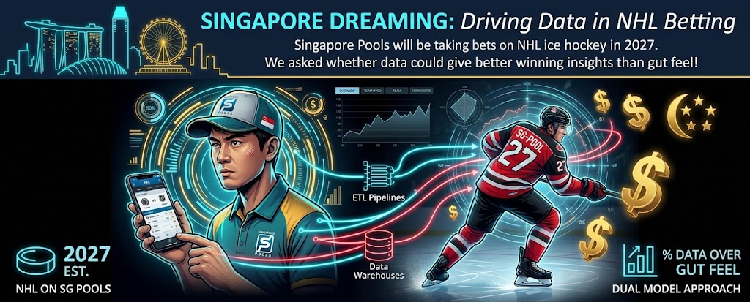
Singapore Dreaming: Driving Data in NHL Betting
Total goals (+5.5) "all in"
Bet on the combined score of both teams
Puckline ("handicap betting")
Favorite (-1.5 goals): must win by 2 or more goals
Underdog (+1.5 goals headstart) must not lose by more than 1 goal
Moneyline ("only 1 match winner")
Predict the winning team excluding overtime and shootouts
Favourite (-) > higher % to win > lower payout
Underdog (+) > lower % to win > higher payout

Slide 5
Objectives
Objectives
1
Transform raw historical Kaggle datasets into a pipeline of clean, reliable data
1
Build the pipeline foundation
1
Recommendation to commit a bet into specific seasonal game outcome. Based on bet type - Moneyline, Puckline
and Totals goals.
Predict next year's Stanley Cup Champions
2
Develop two
predictive models
2
2
3
Deliver insights
We connect the gold layer data and predictive models into Power BI dashboards
3
Deliver insights
3

Slide 6




Technology Stack
Microsoft Azure Fabric
Platform
›
›
›
›
›
Kaggle NHL dataset
Source data
Notebooks
Transformation/
Unit testing
Pipelines
Orchestration
Lakehouse
Data storage
Semantic Model
Business-ready
model
Power BI
Reporting and insights
Microsoft DevOps Project
CI/CD and Version control

Slide 7




Challenges
Domain knowledge
Virtually unheard of in sunny Singapore
We had to learn how ice hockey work before we could model it
Data Issue
Duplicates, missing and null values: we had to decide how to handle them
No referential integrity in the data lake, so we enforced it in code
Azure Fabric
New and unfamiliar to Fabric
Free trial account limited by plan/account
No Data Factory: pipelines only, no orchestration
Data modelling
'What should we do next?' took too long
Converting raw data into meaningful performance metrics that are insightful to ice hockey
Notes:
Lack domain knowledge, need to under the game of ice hockey
Azure Fabric free edition limitation
Cannot connect to github, require paid account to setup DevOps
Only those with paid accounts or accounts longer than 90 days can create ON account to get free account
Don't have access to data factory, use pipelines, no orchestration or loading of datalake for example, all notebooks must be connected correct for execution.

Slide 8
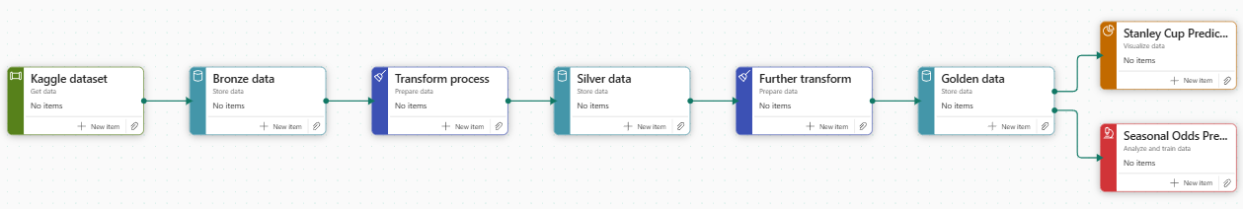
Azure Fabric Medallion Architecture
Bronze phase
Download Kaggle datasets
Create bronze tables
Silver phase
Perform transform process
Create silver tables
Gold phase
Perform further transform
Create gold tables
Create semantic model
Perform PowerBI Analysis and ML modelling.

Slide 9
Exploratory Data Analysis
Clean/Transform
Duplicated rows
Identified duplicates in raw CSVs
Do we pre-clean or leave it to silver phase?
Pre-clean before bronze
Null Values
Some nulls are expected
Some needs to be fill (e.g. nationality)
    Ignore expected nulls and fill in missing values when needed
Referential integrity
Some foreign keys cannot be found
    Drop invalid foreign keys
Data Quality
Validate Categories
Identify which columns are categorical
For example: Type, playerPosition, HoA
Validated categories
Validate Season/game dates
Prevent invalid game dates for a season
Validated game dates against season
Referential integrity
Referential integrity is not enforced in Lakehouse tables
As such, related tables have dependencies
Validate primary/foreign keys
1
2
Decision:
Decision:
Decision:
Decision:
Decision:
Decision:
Notes:
Duplicated rows: identified in raw CSVs (do we pre-clean or leave it to silver phase?)
Referential integrity: Enforced valid foreign keys across: team_id, player_id and game_id
Handling null values:
Expected null values
Filing "Nationality" with "None"
Data, expect player_info and team_info row to update over time, e.g. change of nationality, play position or team name changed
The rest only expect new games to be added, should not have up dated/deleted rows
Column selection
Valid values (e.g. types, position)

Slide 10
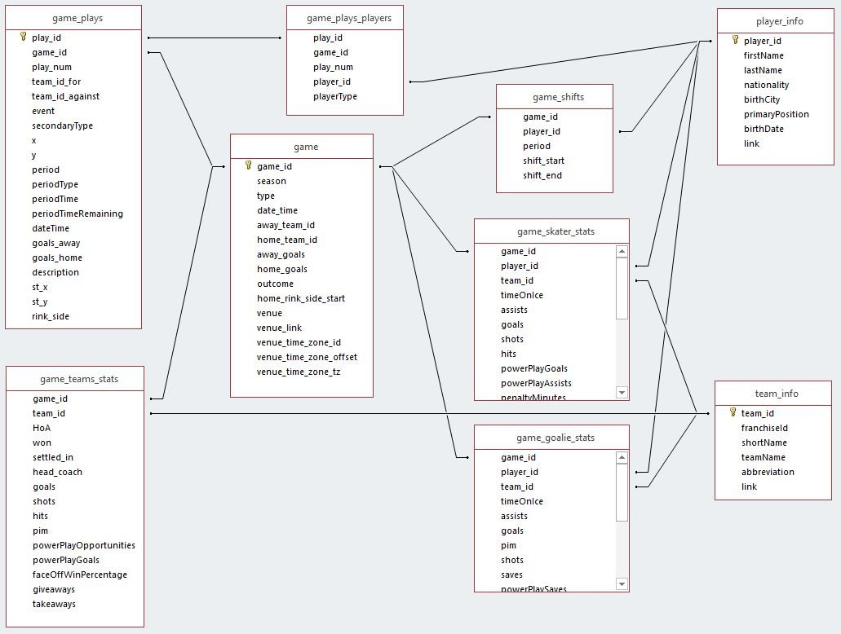
Entity-Relationship Diagram (ERD)

Slide 11
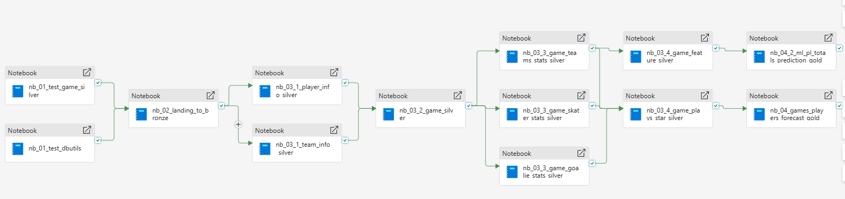
The Actual Pipeline
Bronze phase
Unit testing
  Guard rail
  No CI/CD integration
Dataset download
Create bronze tables
  Deduplicate rows
Silver phase
Step wise transform, not parallel
Create base silver tables
  Cleaning
  Transform
  Validation
Create intermediate silver tables
  Calculated columns
  Joins
Gold phase
Create gold tables
  Aggregation
  Joins
Stanley Cup Predictions
Seasonal Odds ML Predictions

Slide 12
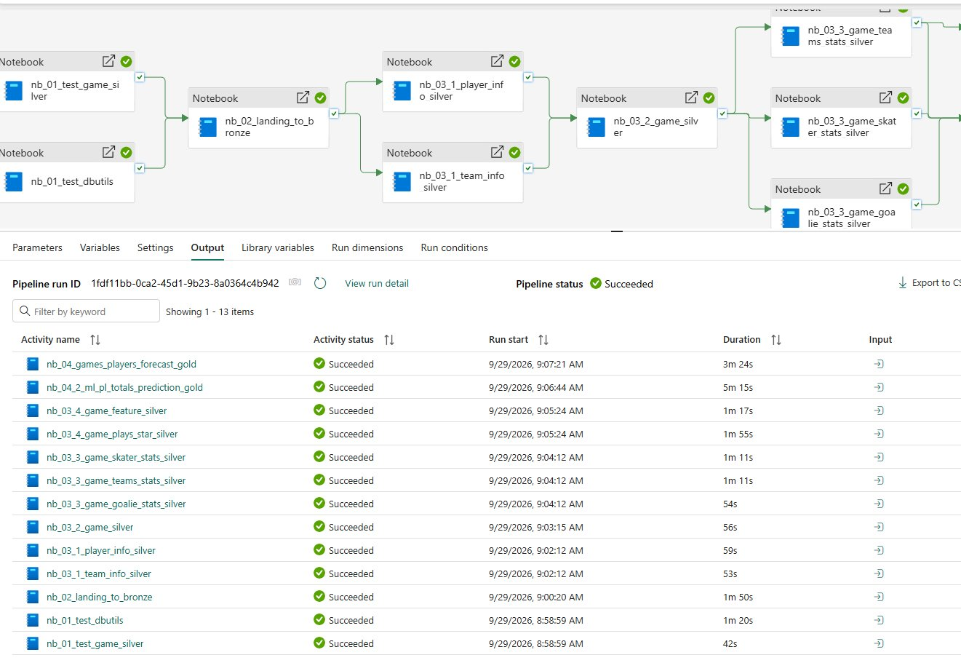
The Actual Pipeline [Successful Run]

Slide 13
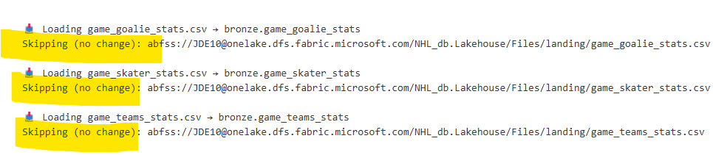
Ensure Idempotency: Tracking File Content Changes
Original assumption: one-time download, tables recreated every run, but what if there are new data?
New assumption: the CSV file name stays the same, but its contents can change.
Player_info and team_info rows can update over time (nationality, position, team name, abbreviation); every other table should only ever gain new rows.
Metatable: dbo_file_manifest table that tracks content changes with a sha-256 key.
Skip same file even if it's
downloaded again
Notes:
Original assumption, one time download, tables recreated every run
What if new data came in, example from new seasons?
Assumption:
the csv file name is always the same, but contents can be different
Updates to rows in player_info and team_info file over time:
Nationality, play position, team name, abbreviation
All other files should only contain new rows, not updated rows
Create audit columns:
CSV download:
Table: dbo_file_manifest (tracks content changes)

Slide 14
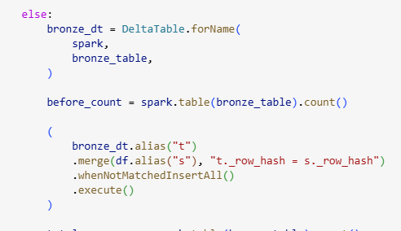
Ensure Idempotency: Bronze [Append Only Merges]
Add audit columns: _ingested_timestamp, _source_file, _row_hash.
Row hash – selected columns to check for updates, e.g. player_id, firstName, lastName & nationality.
Merge Delta table on column hash (_row_hash), so re-ingesting the same file will not duplicates rows.
Cannot use COPY INTO as we are ingesting the same file name.
Only new and updated rows are appended
into bronze tables.
Notes:
Bronze tables:
Only append new and updated rows
Add audit columns:
_ingested_timestamp
_source
_row_hash
Use Deltatable merge:
On _row_hash

Slide 15
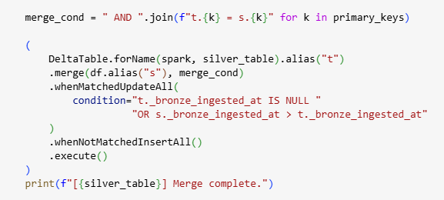
Ensure Idempotency: Silver [SCD Type 1 Upserts]
Adds a _bronze_ingested_timestamp column, silver table tracks this for latest upserts
Upsert (Update + Insert) via Delta table merge, keyed on primary keys and the latest ingested timestamp.
Intermediate silver tables are recreated every run; so are gold tables (due to aggregations and joins)
Silver tables SCD Type 1 tables — updates overwrite, they don’t keep records of past changes.
Notes:
Silver phase
Read only new or updated rows from bronzetable
base silver tables -> SCD Type 1 tables
Adds column:
_bronze_ingested_timestamp
Use Deltatable to upsert
On primary keys AND
latest ingested timestamp
Intermediate silver tables recreated each run
Gold phase
Tables are created with each run

Slide 16
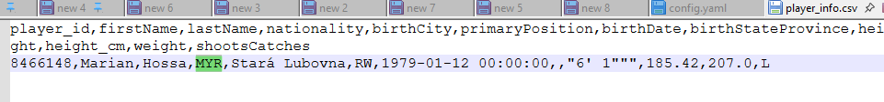
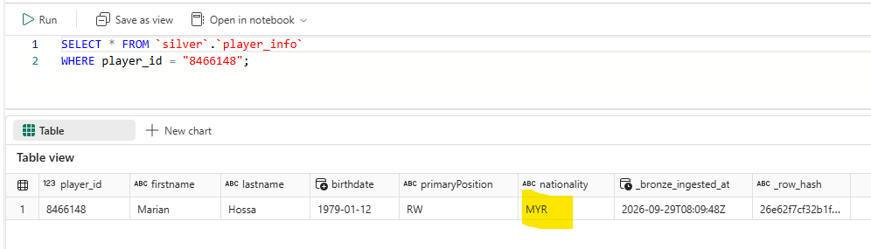
Quick Example: Row Update in Player_Info Dataset
1.1
Player 8466148's original nationality is SVK
1.2
Create a new player_info.csv with an updated nationality
2.1
Final run from the silver phase shows merge done
2.2
Confirm with SQL on the silver table

Slide 17
Optimization and Improvements
Optimization
Flexibility:
  Use metatable, dbo.config_datasets, to define url, datasets and column hash to be ingested
Performance:
  Drop use of count() unless really necessary
  Read/write only required columns early during bronze table creation.
  Use chaining effectively instead of creating yet-another-dataframe
  Filter early: filter run before joins and aggregations.
Schema Evolution:
  Use auto-mergeDelta schema auto-merge (autoMerge.enabled): this handles schema drift without manual table rebuilds.
Improvements
Architecture & Governance
  Implement dedicated Bronze, Silver, and Gold Lakehouses instead of a single Lakehouse.
  Implement a full CI/CD process with Azure DevOps for automated testing and controlled deployments.
Data Quality & Schema Management
  Use explicit schemas when reading CSV files to improve schema drift detection and avoid the overhead of inferSchema=True.
Performance Optimization
  Broadcast small dimension tables, such as team_info table, to reduce shuffle operations during joins.
Delta Lake Optimization
  Implement regular Delta table maintenance using OPTIMIZE and VACUUM.
  Improve query performance using Z-ORDER BY or Liquid Clustering where appropriate.

Slide 18
Sports Betting – The Probability Approach
Sports betting is ultimately a game of quantified probabilities, where long-term profitability relies not on predicting absolute outcomes, but on identifying discrepancies between true event probabilities and the implied probabilities set by bookmaker odds.“
We derived a disciplined, model-driven framework that eliminates emotional bias and capitalizes on bookmaker vigorish gaps.
🎯 The smart choice
Logistic Regression outputs clean probabilities to spot real betting value instead of wild guesses.
📊 Perfect for our data
Thrives on Team A vs Team B "Gap Stats" without over- fitting to random luck.
⚠️ The limitation
Sees straight lines, not complex non-linear drama (which we solve with smart feature pre-selections!).
Notes:
Let's talk about the brain behind this entire operation - Our machine learning model.
You might be asking, 'Why did we pick Logistic Regression?
Isn't that the old-school math tool from the 90s?
Why not use a Deep Neural Network or Decision Tree model?’
Option A: A genius model who overthinks every single detail, including what tie the goalie wore pre-game to the arena. Over-thinking on outlier non-gameplay data. That’s what high-tech models like Neural Networks or Decision Trees do on sports data: they overfit to pure noise.
Option B: Logistic Regression: a calm, disciplined accountant who looks strictly at the core stats, calculates the exact probabilities, and tells you flat out, 'Hey, we have a 68% chance here, and the payout makes sense’.
Here is why it works so well with our specific data:
It talks in pure probabilities: To calculate Expected Value (EV%), we need exact win percentages, not a wild guess.
It thrives on our "Gap Features": We feed the model simple comparative metrics - like Team A’s scoring power minus Team B’s defense.
It doesn't panic over random luck: This model stays simple, it doesn't get distracted by one crazy blowout game last Tuesday.

Slide 19
Sports Betting – The Probability Approach
Sports betting is ultimately a game of quantified probabilities, where long-term profitability relies not on predicting absolute outcomes, but on identifying discrepancies between true event probabilities and the implied probabilities set by bookmaker odds.“
We derived a disciplined, model-driven framework that eliminates emotional bias and capitalizes on bookmaker vigorish gaps.
🎯 The smart choice
Logistic Regression outputs clean probabilities to spot real betting value instead of wild guesses.
📊 Perfect for our data
Thrives on Team A vs Team B "Gap Stats" without over- fitting to random luck.
⚠️ The limitation
Sees straight lines, not complex non-linear drama (which we solve with smart feature pre-selections!).
Notes:
Let's talk about the brain behind this entire operation - Our machine learning model.
You might be asking, 'Why did we pick Logistic Regression?
Isn't that the old-school math tool from the 90s?
Why not use a Deep Neural Network or Decision Tree model?’
Option A: A genius model who overthinks every single detail, including what tie the goalie wore pre-game to the arena. Over-thinking on outlier non-gameplay data. That’s what high-tech models like Neural Networks or Decision Trees do on sports data: they overfit to pure noise.
Option B: Logistic Regression: a calm, disciplined accountant who looks strictly at the core stats, calculates the exact probabilities, and tells you flat out, 'Hey, we have a 68% chance here, and the payout makes sense’.
Here is why it works so well with our specific data:
It talks in pure probabilities: To calculate Expected Value (EV%), we need exact win percentages, not a wild guess.
It thrives on our "Gap Features": We feed the model simple comparative metrics - like Team A’s scoring power minus Team B’s defense.
It doesn't panic over random luck: This model stays simple, it doesn't get distracted by one crazy blowout game last Tuesday.

Slide 20
Prediction Engine: Logistic Regression
Hypothesis function (hθ​(x)) of the Logistic Regression model definition:
Predicted probability of a game outcome occurring, factored by team composite feature gaps
(Training Stats from 2017/18 & 2018/19 Season, Verified with Season 2019/20)
Model Execution Framework
hθ​(x)∈[0,1] | The model gives a smooth percentage confidence score (like 65%).
Expected Value (EV%) | The average profit or loss you expect to make on a bet over time.
Against Bookmaker Odds | Comparing your model's percentage against the sportsbook's price to see if the bet is a smart deal.
TEAM COMPOSITE FEATURE
Predictor Variables:
Goal scoring differential gap per game
Home Power Play Vs Away Penalty Kill
Home Penalty Kill Vs Away Power Play
Shot attempt
Save percentage differential.
OUTCOME VARIABLES
Betting Categories:
Moneyline
Puck Line (+1.5)
Totals (Over 5.5)
Notes:
Let's talk about the brain behind this entire operation - Our machine learning model.
You might be asking, 'Why did we pick Logistic Regression?
Isn't that the old-school math tool from the 90s?
Why not use a Deep Neural Network or Decision Tree model?’
Option A: A genius model who overthinks every single detail, including what tie the goalie wore pre-game to the arena. Over-thinking on outlier non-gameplay data. That’s what high-tech models like Neural Networks or Decision Trees do on sports data: they overfit to pure noise.
Option B: Logistic Regression: a calm, disciplined accountant who looks strictly at the core stats, calculates the exact probabilities, and tells you flat out, 'Hey, we have a 68% chance here, and the payout makes sense’.
Here is why it works so well with our specific data:
It talks in pure probabilities: To calculate Expected Value (EV%), we need exact win percentages, not a wild guess.
It thrives on our "Gap Features": We feed the model simple comparative metrics - like Team A’s scoring power minus Team B’s defense.
It doesn't panic over random luck: This model stays simple, it doesn't get distracted by one crazy blowout game last Tuesday.

Slide 21
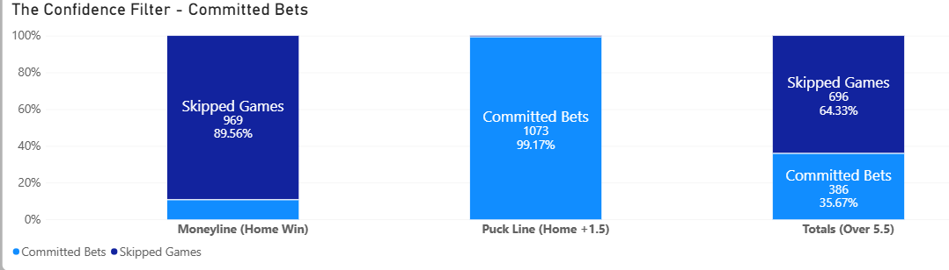
The Bouncer At The Door: How We Filter Out Market Noise
🛑 Moneyline (89.6% Skipped)
Rejects trap games! Only bet when the edge is huge.
🟢 Puckline (99.2% Committed)
Leverages the +1.5 goal safety buffer for maximum volume.
⚖️ Totals (64.3% Skipped)
Filters high-variance games, trades volume for high precision.
We skip 51.6% of market noise to protect capital and maximize portfolio ROI
Notes:
Now, take a look at this chart - We call this 'The Confidence Filter’.
The one take away is this: Our model is extremely picky.
Think of our algorithm as a stern night-club bouncer.
Most novice bettors run into the Singapore casino and bet on every single game. Hey, I paid the entrance fee – must make the most in quick time!
Our bouncer stands at the door, looks at the line-up, and throws out over 50% of the games before we even open our wallet.
Here is how that plays out across our three betting markets:
Moneyline (Home Win): The Ultra-Strict Bouncer
We skipped a whopping 89.56% of games (969 games)! Why? Because straight-up win bets are full of trap odds. Unless the model sees a clear statistical edge, it flat-out refuses to bet.
Puck Line (Home +1.5): The Open Door Policy
Here, we committed to 99.17% of bets (1,073 games). Getting a +1.5 goal cushion means even if our team loses by 1 goal, we still win the bet! The model loves this safety buffer, so almost every game qualifies.
Totals (Over 5.5): The Selective VIP List
Predicting goal totals is tricky business. Our model rejects 64.33% of games (696 games) and only places wagers on the 35.67% (386 games) where goal-scoring trends are crystal clear.
The Bottom Line: Skipping games isn't missing out – it's capital protection. By filtering out 51.6% of the season's background noise, we save our cash strictly for high-conviction, positive-payout opportunities!"

Slide 22
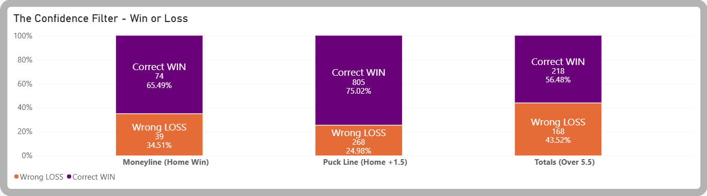
The Indoor Bouncer: Betting Performance & Hit Rate
🛑 Moneyline (65.5% hit rate)
74 Wins / 39 Losses
Quality over quantity pays off with sharp precision.
🟢 Puckline (75.0% hit rate)
805 Wins / 268 Losses
The powerhouse driver of our season-long portfolio gains.
⚖️ Totals (56.5% hit rate)
218 Wins / 168 Losses
Beats Vegas house odds to deliver steady baseline returns.
Selective filtering yields a 70.1% overall win rate and +16.1% portfolio ROI
Notes:
Since our model’s internal bouncer threw out the bad games, what happened to the bets we actually placed?
This chart is the payoff—it shows our actual hit rates across all three market categories!
Moneyline (Home Win): The Sharpshooter
Our pickiness on straight-up wins, paid off! We landed 74 wins and 39 losses, delivering a 65.49% hit rate. By ignoring 89.6% of the risky noise, the model turned a notoriously tough market into a reliable cash generator.
Puck Line (Home +1.5): The Heavyweight Champion
We nailed this category with 805 wins against 268 losses. That is a 75.02% win rate! In sports betting terms, hitting 3 out of every 4 bets is like shooting 75% from the three-point line - it’s an incredible engine for capital growth.
Totals (Over 5.5): The Grinder
Predicting exact game totals in hockey is notoriously chaotic. Yet, our model locked in 218 wins against 168 losses, giving us a 56.48% win rate. In sports betting, anything over 52.4% beats the house fee. At 56.5%, it steadily generates clean profit!
The Bottom Line: We aren't guessing, and we aren't getting lucky. Across 1,572 total committed wagers, this strict filtering process delivered an overall 70.1% portfolio win rate and a +16.1% net ROI!"

Slide 23
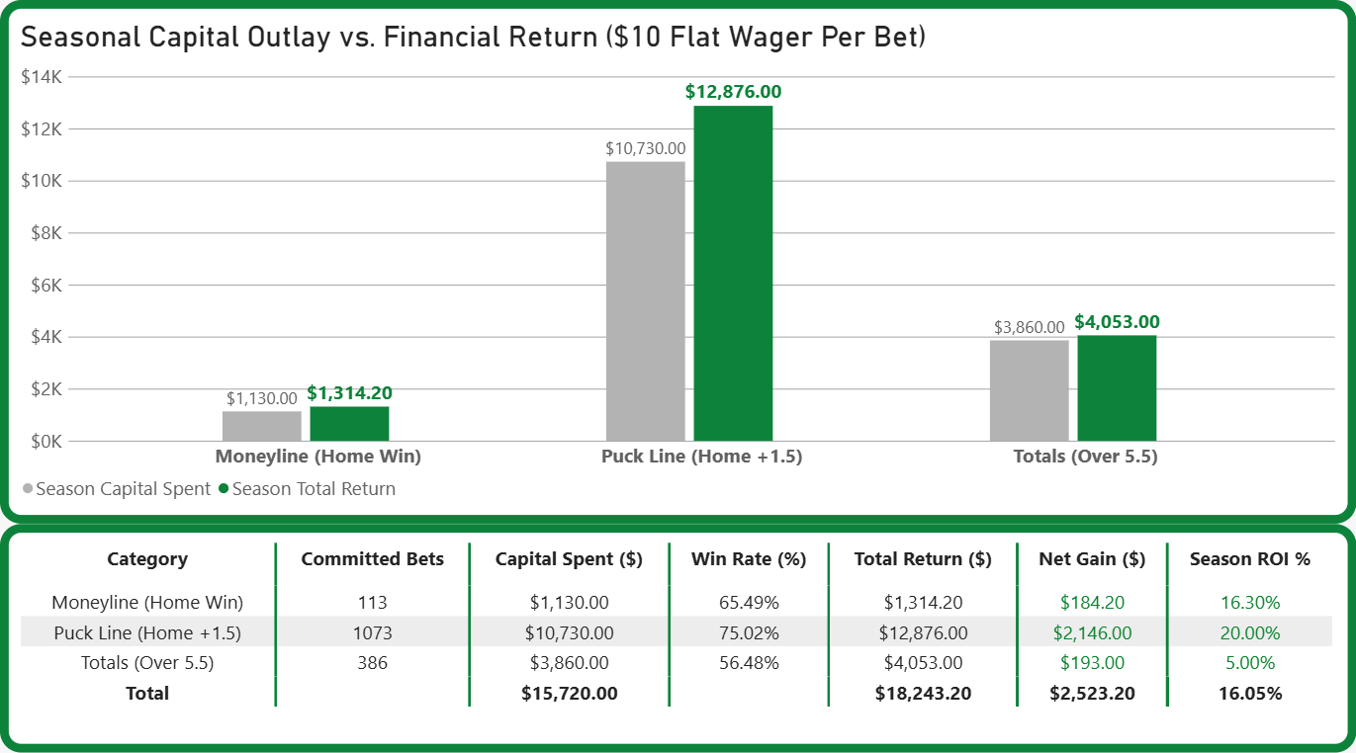
From Model to Money: Portfolio Returns & ROI
🛑 Moneyline (home win): small but mighty
Skipping almost 90% of games!
$184.20 profit and 16.30% ROI
🟢Puck Line (Home +1.5): our MVP
$2,146 profit and 20% ROI
⚖ Totals (over 5.5): steady yield
$193 profit and 5% ROI
Total capital outlay: $15,720
Total cash returned: $18,243.20
Net profit = $2,523.20, 16% ROI
Notes:
What’s the financial payout!
If win rates prove our intelligence, this chart proves our capital efficiency.
We simulated a disciplined strategy of placing a flat $10 wager per qualified bet across the entire season.
Here is how our money worked for us across all three markets:
Puck Line (Home +1.5): The Heavy Cash Cow
We put $10,730 of capital to work here and pulled back $12,876 in gross payouts.
Moneyline (Home Win): Small But Mighty
Well, with just $1,130 wagered, we brought back $1,314.20, pocketing +$184.20 in net gain. That gave us a sharp 16.30% ROI!
It proves that ultra-selective filtering beats risking cash on coin-flip games.
Totals (Over 5.5): Steady Yield
We deployed $3,860 and collected $4,053, resulting in a net profit of +$193.00.
The Big Picture for Stakeholders: Total capital outlay: $15,720. Total cash returned: $18,243.20.

Slide 24
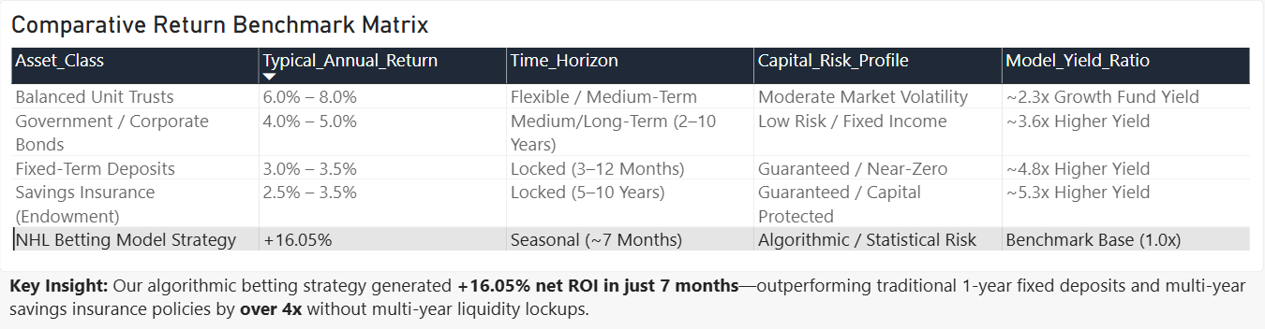
The NHL Predictive Yield Opportunity
We have established the data pipeline, verified the ML algorithms, automated the risk filters, and proven the ROI.
This is a systematic, data-validated, capital-efficient yield engine, not a 'get rich quick' scam
Notes:
In today’s financial landscape, institutional investors and capital managers face a common dilemma:
traditional fixed-income assets yield very little, while traditional markets face high volatility.
Meanwhile, sports betting markets represent a multi-billion-dollar global industry.
Yet 95% of retail participants treat it like gambling, betting with emotion, intuition, and bias.
What if, instead of gambling, we approached sports wagering with the discipline, algorithmic precision, and risk management of a high-frequency quant trading desk?"
Pitch PillarKey Metric / Value Proposition
Systematic Risk Gate - Rejects 51.6% of market noise via dynamic confidence filtering.
Predictive Precision
Achieves a 70.1% overall win rate (75.0% on Puck Line wagers).
Financial Yield
+16.05% Net Portfolio ROI in a single 7-month season.
Asset Comparison
Over 4x higher yield than Fixed Deposits / Savings Insurance.
Let’s stop leaving money on the ice. Join us as a founding partner in this predictive scheme today.
We are offering a systematic, data-validated, capital-efficient yield engine, not a 'get rich quick' scam
We have established the data pipeline, verified the ML algorithms, automated the risk filters, and proven the ROI.
Now, we are opening the scheme to strategic partners who want to participate in the upcoming season's capital deployment.
Let’s stop leaving money on the ice. Join us as a founding partner in this predictive scheme today.

Slide 25
Using Historical Data to Predict Champions
To test accuracy of model
Based on pre-2020 data, we've simulated the 2020–21 NHL season to ​​forecast the Stanley Cup Champion and scoring leader​
Learn
Forecast
Test
Validation
19
31
5.90
2 of 2
seasons of game data
teams ranked
Avg. rank of real
champion
calls landed
Trained on all NHL regular season & playoff games from 2000–01 to 2019–20 (excluding 2004-05 lockout)
Converted team and player metrics into Stanley Cup winning odds and top 10 scorer projections
Validated across 10 past seasons, using prior data only (Rank 1 = exact match)
Evaluated against the 2020-21 actual results: accurately predicted McDavid and the Lightning.
Notes:
Thank you Felix for sharing with us the bouncer betting model.
Imagine it is October 2020, the start of the 2020-21 NHL season, and we are gamblers. The question we ask is simple: can history alone pick the next champion?
Here is our plan in four steps.
Firstly we learn by using every game from 2000-01 to 2019-20, which is 19 seasons, because the 2004-05 season was cancelled by a lockout.
Secondly we forecast by ranking all 31 teams for the Stanley Cup and list the top 10 projected scorers.
Thirdly we test. Before we trust the forecast, we check how it would have done on 10 past seasons.
Lastly, the big reveal: we compare the forecast to what really happened in 2020-21.
The next five slides follow this story: how the forecast is built, what it predicts, how we tested it, how good it was, and finally the reveal.
---------------------
Pretend it is the start of the 2020–21 NHL season. Using only data through 2019–20, forecast who wins the Stanley Cup and who tops the scoring race — then prove the model deserves our money.

Slide 26
How the Forecast Works
No black box: each team gets a recency-weighted score, and the scores are turned into Cup probabilities.
Measure
Weight
Convert
3 · 2 · 1
Softmax
Points %
per team, per season
newest season counts most
scores become Cup odds
The share of available standings points a team actually earned. Regular season only.
Blend the last up to 3 qualifying seasons, so recent form beats old history.
A standard formula (k = 15) turns 31 team scores into probabilities that add up to 100%. Higher score, taller bar.
Illustration (made-up numbers)
points % of 0.65, 0.60, 0.55 → (3×0.65 + 2×0.60 + 1×0.55) ÷ 6 = 0.617
Top scorers
Same 3-2-1 blend on each player’s points, ranked → projected top 10
Notes:
Before showing any predictions, here is how they are made. It is deliberately simple, with no black box.
Step one, measure: for every team in every season, we take its points percentage, which is the share of the available standings points the team actually earned.
Step two, weight: we blend the team's last three seasons, counting the newest season three times, the one before it twice, and the oldest once. So recent form matters most. The example at the bottom uses made-up numbers just to show the arithmetic.
Step three, convert: a standard formula called softmax turns all 31 team scores into probabilities that add up to 100 percent. Higher score, bigger probability, taller bar on the next slide. Top scorers work the same way, using each player's points instead of the team's.
The upside is that every pick can be explained in one sentence. The downside is that it only knows past results, nothing about injuries or trades.

Slide 27
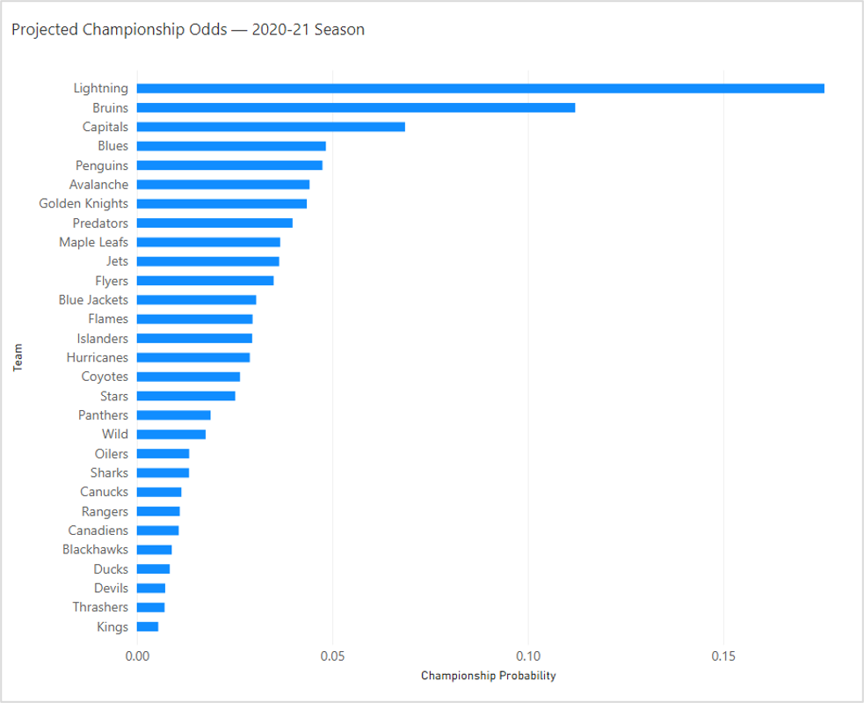
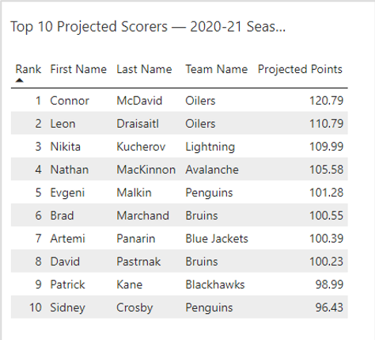
Predicted Winners
The model's live forecast for the 2020–21 season — this is the page you'd actually bet from
Ranked by projected regular-season points
Using This to Bet
•Biggest bar = the model's favorite to win it all
•Gap between bars shows how confident the model is
•Top-10 table doubles as a top-scorer prop-bet list
Taller bar = higher modeled championship probability
Notes:
This is what the model produces for the 2020-21 season, and it is the page you would actually bet from.
On the left, each bar is one team's chance of winning the Cup. The taller the bar, the more the model likes that team. Tampa Bay is the favorite, followed by Boston and Washington. Notice there is no runaway winner: the favorite is well under a 50 percent chance, and the gap between bars shows how confident the model is.
On the right is our top scorer list. Connor McDavid is projected first, ahead of Leon Draisaitl and Nikita Kucherov.
How would a gambler use this? Compare the model's probability for a team with the odds the sportsbook is offering. Where the model thinks a team is more likely than the sportsbook does, that gap is where you would look for value. The top-10 table works the same way for top-scorer bets.

Slide 28
Validation Testing
Before betting on 2020–21, we replayed history and forecast each past season using only what was known at the time.
Seasons we forecast blind
2010–11
2011–12
2012–13
2013–14
2014–15
2015–16
2016–17
2017–18
2018–19
2019–20
Each forecast only sees seasons BEFORE the one it predicts: no peeking
10
5.90
2010–11
seasons scored
avg rank of the real champion
earliest season we
could score
Each had a real, known champion to compare against.
1 means our #1 pick won. A random guess among ~30 teams averages about 15–16.
The source data has no playoff games before then, so we stopped there rather than guess.
Notes:
A forecast is only worth betting on if it has been tested, so here is how we tested it.
Across the top are ten past seasons, 2010-11 through 2019-20. For each one, we pretended to stand just before that season and gave the model only earlier data. It then ranked all the teams, and we looked at where the real champion landed in our ranking. The blue bar is the key rule: no peeking at the future.
Three numbers. Ten seasons scored. An average rank of 5.90 for the real champion, where 1 means our top pick won. To put 5.90 in context, a random guess among about 30 teams would average around 15 or 16. And 2010-11 is the earliest season we could score, because the source data has no playoff games before then. We chose to stop there rather than guess. That gap does not affect the 2020-21 forecast, which only uses regular-season results.

Slide 29
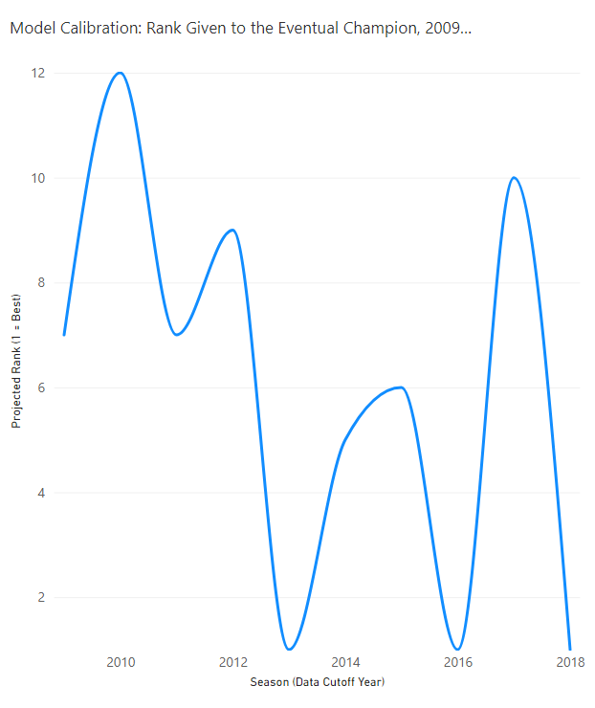
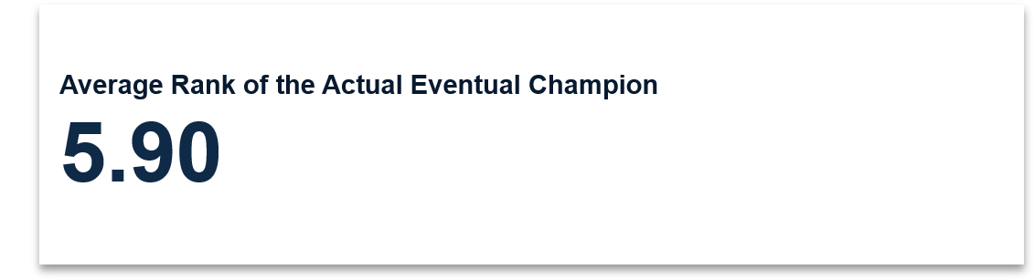
How Good Is the Model?
What we tested
•Before trusting this on a real season, we made the model predict champions for 10 past seasons it hadn't seen, using only data from before each one.
•Each point on the chart is one tested season — the lower it sits, the closer our top pick was to the real champion (1 = nailed it exactly).
•Some seasons we called almost exactly; others missed by a wide margin — averaging out to a projected rank of 5.90 across the decade.
Notes:
Here are the results of that test. Each point on the line is one tested season. The lower the point, the closer our top pick was to the real champion, and 1 means we nailed it.
You can see it is not perfect. In some seasons the real champion was our top one or two picks. In others the model missed by a wide margin, and at its worst the real champion was ranked around 12th. Averaged over the ten seasons, the champion landed at rank 5.90, shown in the card on the right.
So our honest read: the model is clearly better than guessing, but it is not a crystal ball. That is why, in the story, we treat it as a way to find an edge over many bets, not as a sure thing.

Slide 30
The Reveal
Trained only on data through 2020 — then pointed at a season that had already happened
2020-2021 Season | Our Prediction | Reality
Best Player | McDavid | Connor McDavid
Stanley Cup Champion | Lightning | Tampa Bay Lightning
Both calls landed: the model's top pick for Best Player (McDavid)
and Stanley Cup Champion (Lightning) matched reality exactly.
Notes:
Now the reveal. The model only ever saw data through 2019-20. We then compared its 2020-21 forecast to what actually happened.
Best player: the model picked McDavid, and Connor McDavid won the scoring race. Stanley Cup champion: the model picked the Lightning, and Tampa Bay won the Cup. Both calls landed, even in a strange, COVID-shortened season.
One word of caution before we celebrate: two correct calls is encouraging but is a small sample. The reason we trust the model is the ten-season test we just saw, not this single result. Together they say the same thing: history gives you a real, measurable edge, which is why this is a forecast to bet on and not a guess.

Slide 31
Last Call: Two Formulas, Perked Up
From coffee towkays to pro max ice hockey bankers: your order is ready.
FORMULA 1
FORMULA 2
The Bouncer
The Historian
Game-by-game betting model (logistic regression)
Stanley Cup and top-scorer forecast (19 seasons of history)
+
+16%
70% win rate
51.6% of games skipped
$2,523 net profit on $15,720
5.90
2 of 2 calls landed in 2020–21
10 seasons blind-tested
31 teams ranked
ROI on a flat $10 per bet
avg rank of the real champion (random guess ≈ 15–16)
Picky beats busy: it only bets when the edge is real.
Using only pre-2020 data, it called McDavid and the Lightning.
One shared ingredient: one Fabric pipeline (Bronze → Silver → Gold) fed both models
Data over gut feel. See you at the Singapore Pools counter in 2027.
Back-tested simulation at a flat $10 per bet. Not a guarantee of future results. Please bet responsibly.
Notes:
We started this talk as coffee towkays promising you two winning formulas to perk up your mornings. Here is your order.
Formula one is The Bouncer, our game-by-game betting model as shared by Felix.
It is a logistic regression that stands at the door and throws out more than half of the games, 51.6 percent, so we only bet when the edge is real. On a flat ten-dollar bet it won about 70 percent of the time and turned $15,720 of capital into $2,523 of profit, roughly a 16 percent return.
Formula two is The Historian, our season-long forecast as shared by myself.
It learned from 19 seasons of history, was blind-tested on 10 past seasons, ranked the real champion at 5.90 on average where a random guess would be 15 or 16, and then called both the 2020-21 scoring leader and Stanley Cup winner: McDavid and the Lightning.
So the message is simple: data beats gut feel. Singapore Pools starts taking NHL bets in 2027, and we will be ready. One last honest note: these are back-tested simulations, not guarantees, so please bet responsibly. Thank you, and we are happy to take questions.

Slide 32
The End

Slide 33
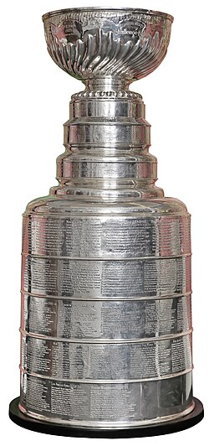
An intro to Ice Hockey
The National Hockey League (NHL) comprises 32 teams across US and Canada, playing 82 games per season.
A season runs about 9 months: preseason, regular season, and the playoffs.
It is a dynamic game with frequent player substitutions which create complex team performance variables.
Teams score by putting the puck in the net
Defenseman 1
Forward 1
Goalie
Forward 2
Forward 3
Defenseman 2

Slide 34
Singapore Dreaming:
Driving data in NHL betting
Singapore Pools will be taking bets on NHL ice hockey in 2027.
We asked whether data could give better winning insights than gut feel!
Total goals "all in"
We bet on the total score of both teams, add up everything.
Over if total goals >the set number for exciting game
Under if total goals < set number, usually for boring, defense-heavy game
Moneyline "who will win?'
Out of 2 teams, pick the winner to win the match including extra time.
Favourite (+) = stronger team = higher % to win = lower payout
Underdog (-) = weaker team = high risk to lose = but huat ah, bigger payout!
Puckline "like EPL goal handicap"
Favorite (-1.5 goals) e.g. Liverpool who will win by 2 or more goals
Underdog (+1.5 goals headstart) e.g. Southhampton who will win if they draw or lose by only 1 go

Slide 35
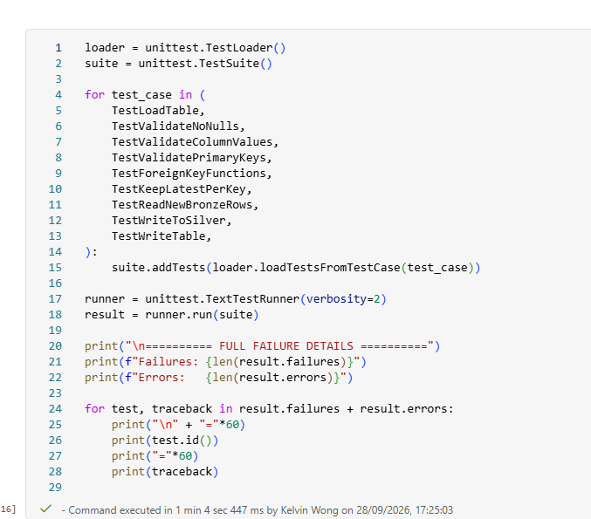
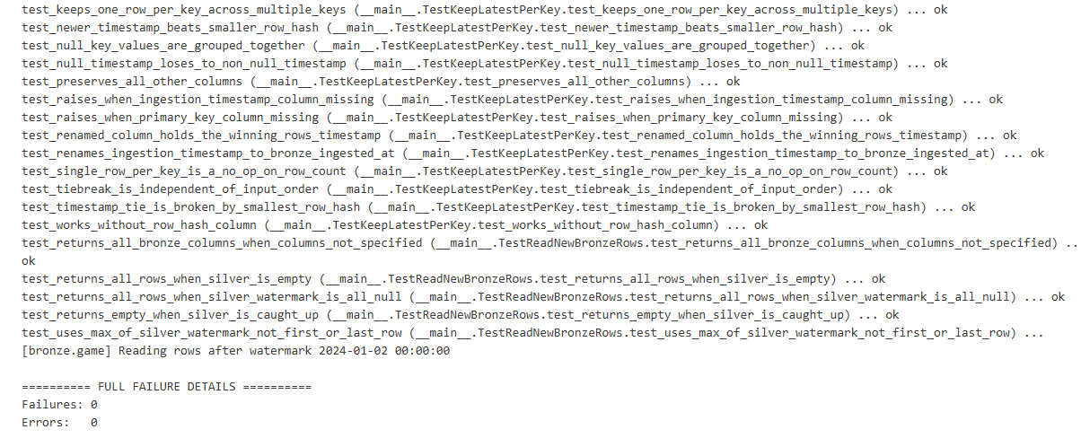
Unit testing
Uses unittest, MagicMock (mock pyspark functions) to perform white box test
Built-into Azure Fabric, no additional install necessary
Serves as a guard rail due to lack of CI/CD integration
Ensures cleaning, transformation and validation functions passes before pipeline runs

Slide 36
The Engine: Logistic regression
🎯 The smart choice
Outputs clean probabilities to spot real betting value instead of wild guesses.
📊 Perfect for our data
Thrives on Team A vs Team B "Gap Stats" without over- fitting to random luck.
⚠️ Limitation
Sees straight lines, not complex non-linear drama (which we solve with smart feature pre-selections).
Notes:
Let's talk about the brain behind this entire operation - Our machine learning model.
You might be asking, 'Why did we pick Logistic Regression?
Isn't that the old-school math tool from the 90s?
Why not use a Deep Neural Network or Decision Tree model?’
Option A: A genius model who overthinks every single detail, including what tie the goalie wore pre-game to the arena. Over-thinking on outlier non-gameplay data. That’s what high-tech models like Neural Networks or Decision Trees do on sports data: they overfit to pure noise.
Option B: Logistic Regression: a calm, disciplined accountant who looks strictly at the core stats, calculates the exact probabilities, and tells you flat out, 'Hey, we have a 68% chance here, and the payout makes sense’.
Here is why it works so well with our specific data:
It talks in pure probabilities: To calculate Expected Value (EV%), we need exact win percentages, not a wild guess.
It thrives on our "Gap Features": We feed the model simple comparative metrics - like Team A’s scoring power minus Team B’s defense.
It doesn't panic over random luck: This model stays simple, it doesn't get distracted by one crazy blowout game last Tuesday.

Slide 37
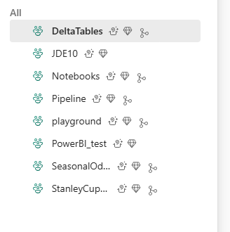
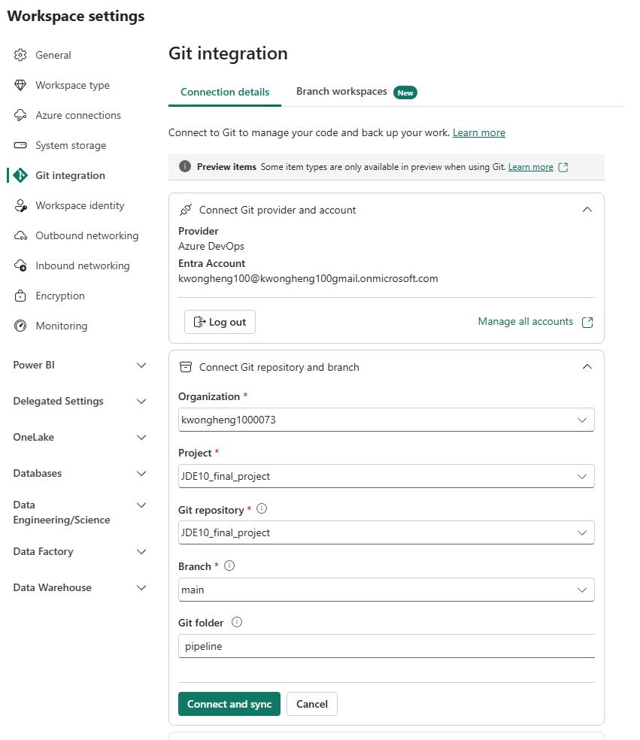
Azure DevOps setup in Farb
Create different workspace as folders
Same account integration to DevOps

Slide 38
Azure DevOps project

Slide 39
